Slide 1

Specialization
.Net 4.5.2, vNext, CLR Internals
C# 6.0, WPF 4.5 .2 with Blend
ASP.Net 5,0, ASP.Net MVC 6.0
Linq 4 & ADO.Net EF 7.0
WCF 4.5.1, Web API, WF 4.5.1
.Net Micro Framework
Prism 5 with MEF & MVVM
Cloud Computing (Azure)
UML 2 and OOAD
HTML 5, CSS 3, SASS/LESS
65 .Net Design Patterns
JavaScript, ES6, Jquery 2.x , Bootstrap
Ext JS 6, TypeScript, Angular 2.0, immutable, React , Redux , Backbone
Kendo UI, D3.js, Polymer js
Node.js, Elastic search, EJS ,Mongo
hapi.js, system.js, phantom.js
Mocha, QUnit, Jasmine,karma
Webpack,Grunt,Gulp, youman
ES6, Typescript,
React & Redux
D.S.R.Murthy M.Tech (IT)
Software Architect & Corporate Trainer
Experience : 25 years

Slide 2

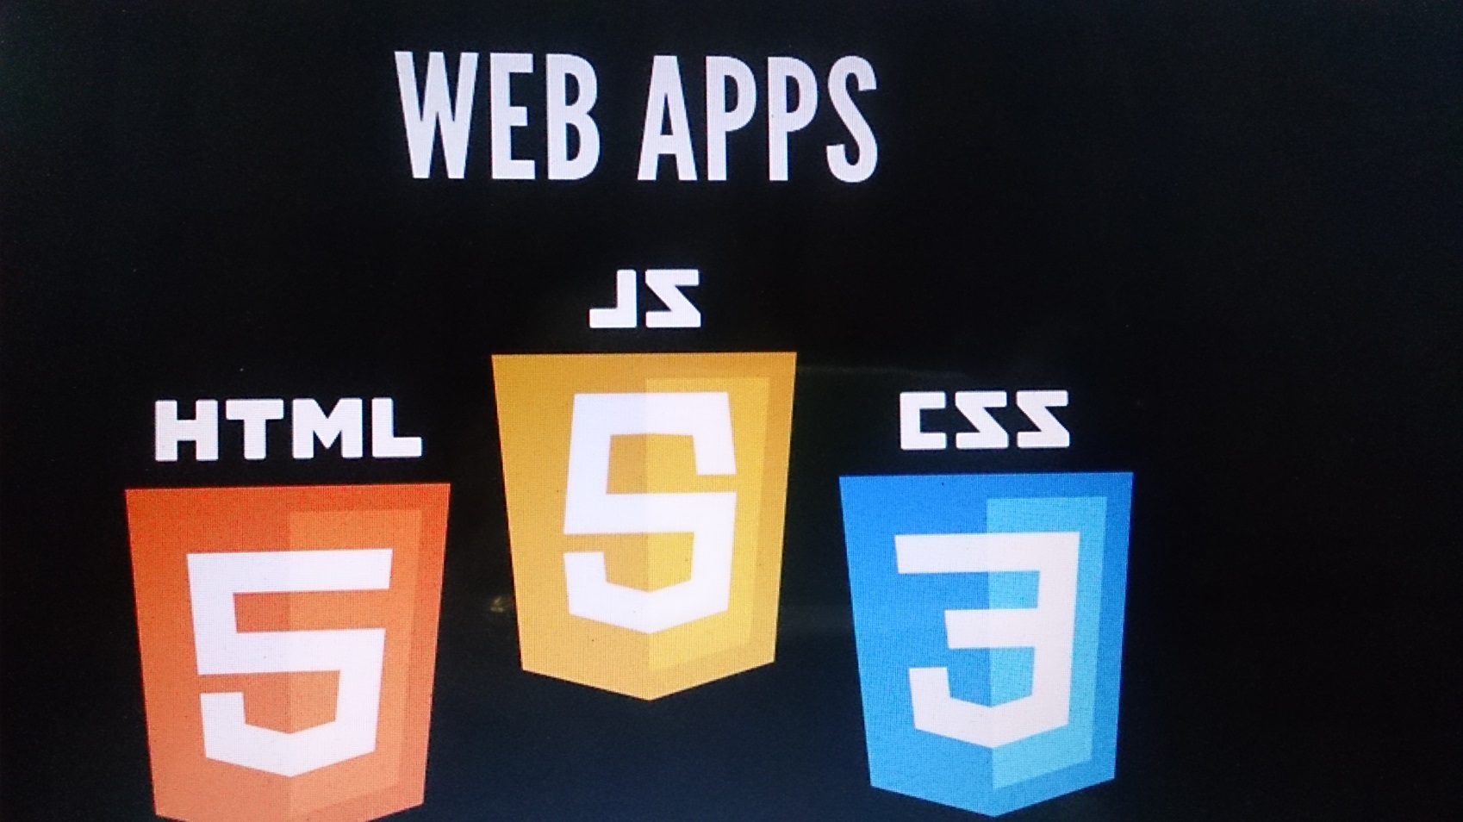
Web Technology Now

Slide 3
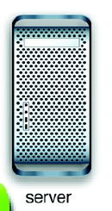

ECMAScript 6 – ES 6
Web Architecture
HTML + Java Script + Jquery
CSS 3 /Bootstrap
Google Chrome V8 JS engine
http (s)
server
HTTP (s) / Sockets
Web
socket
SQLServer
MongoDB
Angular JS
React
Ext JS
…
Node JS
Google V8 java script Engine

Slide 4
History
1990 : HTML → HTTP (www) → CGI → PERL
1995: JavaScript
2000: XMLHttpRequest
2006: jQuery (Library)
2010: Angular JS (Framework) – Misko Hevery
Reduced GWT based Feedback project 17000 lines code to 1500 lines code on bet in just 3 weeks. Later in more than 100 Google projects it is used
Other Client Side MVC frameworks:
Backbone JS, Ext JS, Ember JS …..

Slide 5
ECMAScript 6 – ES 6
JavaScript was developed by Brendan Eich, a developer at Netscape Communications Corporation, in 1995.
JavaScript started life with the name Mocha, and was briefly named LiveScript before being officially renamed to JavaScript.
ECMAScript (or ES) is a trademarked scripting-language specification standardized by Ecma International in ECMA-262 and ISO/IEC 16262.
ECMAScript6 is also called as
“ES6″, “Harmony” and “ES.next”.

Slide 6
ECMA 6
Java Script is one implementation of a standard specification, called ECMAScript. (ECMA5 is present).
The new version now is ECMA SCRIPT 6, ES6, or
ECMASCRIPT 2015. (ECMA 7 is in pipeline)
Angular 2 and React JS has been designed to take advantage of the brand new version of JavaScript (ES 6).

Slide 7
ECMA 6
A transpiler takes ES6 source code and generates ES5 code that can run in every browser.
It even generates the source map files, which allows to debug directly the ES6 source code from the browser.
Transpilers:
• Traceur, a Google project
• Babeljs (used in react js)

Slide 8
ECMA 6 – Features
Support for constants
Block Scope
Fat Arrow Functions
Extended Parameter Handling
Template Literals
Extended Literals
Enhanced Object Properties
De-structuring Assignment
Modules
Classes
Iterators
Generators
Collections
New built in methods for various classes
Promises

Slide 9
ECMA 6
Build Tools
Grunt
Gulp
Webpack
IDE’s
Notepad ++
VS code / Visual Studio 2013/2015
Sublime .Text 3.0
JetBrains
Aptana Studio
Eclipse
Brackets

Slide 10
ECMA 6
Brackets
Brackets is a free open-source editor for web development, created by Adobe Systems.
It is available for Linux, Windows and Mac OS X. Brackets is available at
http://brackets.io

Slide 11
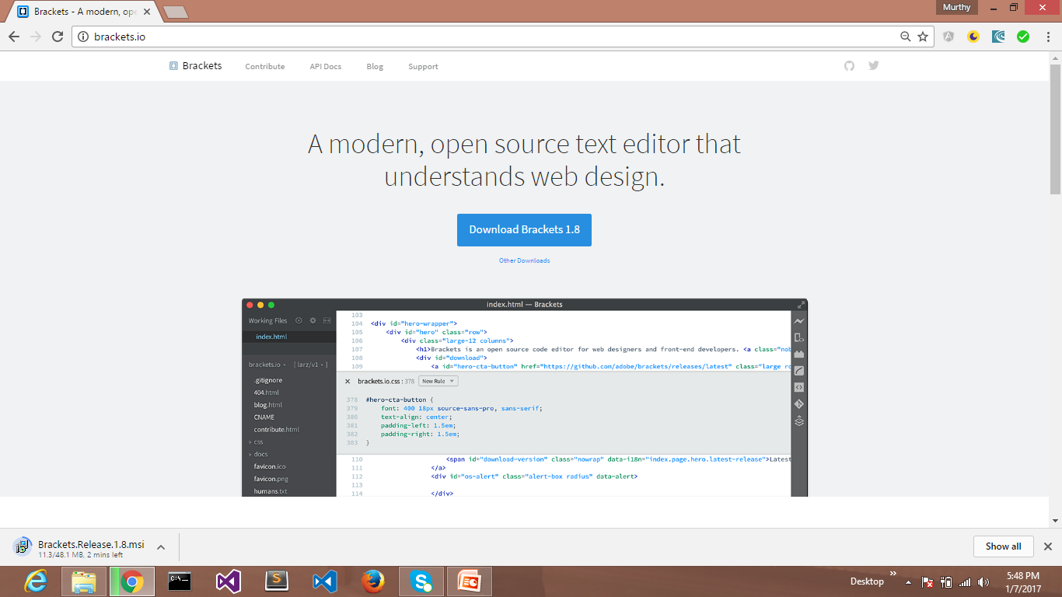
ECMA 6
Brackets
Brackets is a free open-source editor for web development, created by Adobe Systems.
It is available for Linux, Windows and Mac OS X. Brackets is available at
http://brackets.io

Slide 12
ECMA 6 – Features
Build Tools
Grunt
Gulp
Webpack
IDE’s
Notepad ++
VS code / Visual Studio 2013/2015
Sublime .Text 3.0
JetBrains
Aptana Studio
Eclipse

Slide 13
ECMA 6 – Features
Node.js is an open source, cross-platform runtime environment for server-side JavaScript.
Node.js is required to run JavaScript without a browser support.
It uses Google V8 JavaScript engine to execute the code.
Node is available at
https://nodejs.org/en/download

Slide 14
ES6
A JavaScript program can be composed of:
Variables: Represents a named memory block that can store values for the program.
Literals: Represents constant/fixed values.
Operators: Symbols that define how the operands will be processed.
Keywords: Words that have a special meaning in the context of a language.
Modules: Represents code blocks that can be reused across different programs/scripts.

Slide 15
ES6
Comments: Used to improve code readability.
Identifiers: These are the names given to elements in a program like variables, functions, etc.
The rules for identifiers are:
o Identifiers can include both, characters and digits. However, the identifier cannot begin with a digit.
o Identifiers cannot include special symbols except for underscore (_) or a dollar sign ($).
o Identifiers cannot be keywords. They must be unique.
o Identifiers are case sensitive. Identifiers cannot contain spaces.

Slide 16
ES6
JavaScript is Case-sensitive
This means that JavaScript differentiates between the uppercase and the lowercase characters.
Semicolons are Optional
Each line of instruction is called a statement. Semicolons are optional in JavaScript.
eg : console.log("hello world")
Comments
Comments are a way to improve the readability of a program.
Single-line comments (//): Any text between a // and the end of a line is treated as a comment.
Multi-line comments (/* */): These comments may span multiple lines.

Slide 17
ES6
The Strict Mode
The Strict Mode imposes a layer of constraint on JavaScript. It makes several changes to normal JavaScript semantics.
The code can be transitioned to work in the Strict Mode by including the following:
"use strict";
v = "Hi! “; // ERROR: Variable v is not declared

Slide 18
ES6
ES6 and Hoisting
The JavaScript engine, by default, moves declarations to the top
called hoisting.
This feature applies to variables and functions.
Hoisting allows JavaScript to use a component before it has been declared.
The concept of hoisting does not apply to scripts that are run in the Strict Mode.

Slide 19
ES6
JavaScript and Dynamic Typing
Variable initialization refers to the process of storing a value in the variable. A variable may be initialized either at the time of its declaration or at a later point in time.
var name=“Sriram”
JavaScript is an un-typed language.
JavaScript variable can hold a value of any data type.
The value type of a variable can change during the execution of a program and JavaScript takes care of it automatically. This feature is termed as dynamic typing.

Slide 20
ES6
JavaScriptVariable Scope
The scope of a variable is the region of your program in which it is defined.
Global Scope: A variable with global scope can be accessed from within any part of the JavaScript code.
Local Scope: A variable with a local scope can be accessed from within a function where it is declared.

Slide 21
ES6
var num=10 //Global Scope
function test()
{
var num=100 // local scope
console.log("value of num in test() "+num) //100
}
console.log("value of num outside test() "+num) //10
test()
ES6 defines a new variable scope - The Block scope.

Slide 22
ES6
"use strict"
function test()
{
var num=100
console.log("value of num in test() "+num) //100
{
console.log("Inner Block begins")
let num=200 // Block scope
console.log("value of num : "+num) //200
}
}
test()
console.log(num); //?

Slide 23
ES6
var no =10;
var no =20;
console.log(no); //20
let no =10;
let no =20;
console.log(no); //thorows error

Slide 24
ECMA 6
let keyword: (work at block scope)
function getFullName(sri) {
if (sri.isChampion) {
let name = 'Champion ' + sri.name;
return name;
}
// name is not accessible here
return sri.name;
}
The variable name is now restricted to its block. let has been introduced to replace var in the long run.

Slide 25
ECMA 6
The const
The const declaration creates a read-only reference to a value i.e variable identifier cannot be reassigned.
Constants are block-scoped, much like variables defined using the let statement.
The value of a constant cannot change through re-assignment, and it can't be re-declared.

Slide 26
ECMA 6
The following rules hold true for a variable declared using the const keyword:
Constants cannot be reassigned a value.
A constant cannot be re-declared.
A constant requires an initializer i.e. constants must be initialized during its declaration.
The value assigned to a const variable is mutable.
const x=10
x=12 // will result in an error!!

Slide 27
ECMA 6
Constants
const PI = 3.14;
const SRI= {};
SRI.color = ‘white'; // works
But you can’t assign another object:
const SWEETY = {};
SWEETY = {color: 'blue'}; // SyntaxError

Slide 28
ECMA 6
An expression is a special kind of statement that evaluates to a value. Every expression is composed of:
Operands: Represents the data.
Operator: Defines how the operands will be processed to produce a value.
In 2 + 3, 2 and 3 are operands and the symbol + (plus) is the operator. JavaScript supports the following types of operators:
1. Arithmetic operators 2. Logical operators 3. Relational operators 4.Bitwise operators 5. Assignment operators 6. Ternary/conditional operators 7. String operators 8. Type operators 9.The void operator Demo : Operators.html

Slide 29
Functions

Slide 30
ES6
Functions are the building blocks of readable, maintainable, and reusable code.
Functions are defined using the function keyword.
//define a function
function test()
{
console.log("function called")
}
//call the function
test()

Slide 31
ES6
//Parameters
function add( n1,n2)
{
var sum=n1 + n2
console.log("The sum of the values entered "+sum)
}
add(12,13)

Slide 32
ECMA 6
Default parameters and values
One of the characteristics of JavaScript is that it allows developers to call a function with any number
of arguments:
• if you pass more arguments than the number of the parameters, the extra arguments are ignored
• if you pass less arguments than the number of the parameters, the missing parameter will be set to
undefined.

Slide 33
ECMA 6
Default parameters and values
function getPonies(size = 10, page = 1) {
// ...
server.get(size, page);
}
// default can be even function call
function getPonies(size = defaultSize(), page = 1) {
// the defaultSize method will be called if size is not provided
// ...
server.get(size, page);
}

Slide 34
ECMA 6
Default parameters and values
// or even variables, global variables…
function getPonies(size = defaultSize(), page = size - 1) {
// if page is not provided, it will be set to the value
// of the size parameter minus one.
// ...
server.get(size, page);
}

Slide 35
ES6
Rest Parameters
Rest parameters are similar to variable arguments in Java.
Rest parameters doesn’t restrict the number of values that you can pass to a function.
The values passed must all be of the same type.
Rest parameters act as placeholders for multiple arguments of the same type.

Slide 36
ES6
function fun1(...params) {
console.log(params.length);
}
fun1();
fun1(5);
fun1(5, 6, 7);
Demo: Functions/functions.html

Slide 37
ES6
Anonymous Function
Functions that are not bound to an identifier (function name) are called as anonymous functions.
These functions are dynamically declared at runtime.
Anonymous functions can accept inputs and return outputs, just as standard functions do.
An anonymous function is usually not accessible after its initial creation.
Variables can be assigned an anonymous function. Such an expression is called a function expression.

Slide 38
ES6
The Function Constructor
var variablename = new Function(Arg1, Arg2..., "Function Body");

Slide 39
ES6
Lambda Functions
Lambda refers to anonymous functions in programming. Lambda functions are a concise mechanism to represent anonymous functions. These functions are also called as Arrow functions.
Lambda Function - Anatomy There are 3 parts to a Lambda function:
Parameters: A function may optionally have parameters.
The fat arrow notation/lambda notation (=>): It is also called as the goes to operator.
Statements: Represents the function’s instruction set
var foo=(x)=>10+x
console.log(foo(10))

Slide 40
ES6
IIEF: Immediately invoking Executing Function
( function (name){
var x=10;
console.log(name);
})(‘Murthy’)

Slide 41
ECMA 6
Void and Immediately Invoked Function Expressions
When using an immediately-invoked function expression, void can be used to force the function keyword to be treated as an expression instead of a declaration.
void function iife_void()
{
var msg = function () {console.log("hello world")};
msg();
}();
//output : hello world

Slide 42
ES6
Generator Functions
When a normal function is invoked, the control rests with the function called until it returns. With generators in ES6, the caller function can now control the execution of a called function.
The function can yield control back to the caller at any point.
When you call a generator, it doesn’t run right away. Instead, you get back an iterator. The function runs as you call the iterator’s next method.
Generators are denoted by suffixing the function keyword with an asterisk; otherwise, their syntax is identical to regular functions. (Demo : Generator.html)

Slide 43
Events

Slide 44
ES6
Events:
Events are used to interactivity to web page.
Events are a part of the Document Object Model (DOM) Level 3 and every HTML element contains a set of events that can trigger JavaScript Code.
On the occurrence of an event, the application executes a set of related tasks called eventhandler.
Every HTML element has a set of events associated with it. We can define how the events will be processed in JavaScript by using event handlers.

Slide 45
ES6 new features

Slide 46
ES 6
JavaScript supports extending data types.
JavaScript objects are a great way to define custom data types.
An object is an instance which contains a set of key value pairs.
Unlike primitive data types, objects can represent multiple or complex values and can change over their life time.
The values can be scalar values or functions or even array of other objects.

Slide 47
ES 6
Object Initializers
Like the primitive types, objects have a literal syntax: curly braces ({and}).
var identifier= {Key1:value, Key2: function () {
//functions
},
Key3: [“content1”,” content2”]
}

Slide 48
ECMA 6
var person={
firstname:"Tom",
lastname:"Hanks",
func:function(){return "Hello!!"},
};
//access the object values
console.log(person.firstname)
console.log(person.lastname)
console.log(person.func())

Slide 49
ECMA 6
Creating objects
function createSri() {
let name = 'Rainbow Dash';
let color = 'blue';
return { name: name, color: color };
}
can be simplified to
function createSri() {
let name = 'Rainbow Dash';
let color = 'blue';
return { name, color };
}
alert(createSri().name+ "-"+ createSri().color)

Slide 50
ECMA 6
A class can have getters and setters
class Demo {
get color() {
console.log('get color');
return this._color;
}
set color(newColor) {
console.log(`set color ${newColor}`);
this._color = newColor;
}
}
let car = new Demo();
car.color = 'red'; // set color red
console.log(car.color); // get color

Slide 51
ECMA 6
Rest operator
ES6 introduces a new syntax to define variable parameters in functions.
function addPonies(ponies) {
for (var i = 0; i < arguments.length; i++) {
poniesInRace.push(arguments[i]);
}
}
//Better syntax with ES6
addPonies('Rainbow Dash', 'Pinkie Pie');
function addPonies(...ponies) {
for (let pony of ponies) {
poniesInRace.push(pony);
}}

Slide 52
ECMA 6
Classes
ES6 introduces classes to JavaScript!
Now we can use classes and inheritance in JavaScript.
class Demo {
constructor(color) {
this.color = color;
}
toString() {
return `${this.color} car`;
// called template literals with backtick
}
}
let d = new Demo('blue');
console.log(d.toString()); // blue car

Slide 53
ECMA 6
It can also have static attributes and methods:
class Demo {
static defaultSpeed() {
return 10;
}
}
Static methods can be called only on the class directly:
let speed = Demo.defaultSpeed();

Slide 54
ECMA 6
Inheritance:
class Vehicle {
speed() {
return 10;
}
}
class Car extends Vehicle {
}
let c = new Car();
console.log(c.speed());

Slide 55
ECMA 6
class Vehicle {
speed() {
return 10;
}
}
class Car extends Vehicle {
speed() {
return super.speed() + 10;
}
}
let c = new Car();
console.log(c.speed());
// 20, as Car overrides the parent method
The super keyword can also be used in constructors, to call the base class constructor:

Slide 56
ECMA 6
Arrow functions
'fat arrow' operator (⇒). It is useful for callbacks and anonymous functions!
getUser(login)
.then(user => getRights(user))
.then(rights => updateMenu(rights))

Slide 57
ECMA 6
Promises
Promises aim to simplify asynchronous programming.
Javascript code is full of async stuff, like AJAX
requests, and use callbacks to handle the result and the error.
But it can get messy, with callbacks inside callbacks, and it makes the code hard to read and to maintain.
Promises are much nicer than callbacks, as they flatten the code, and thus make it easier to understand.

Slide 58
ECMA 6
Promises usecase :
Fetch a user, then its rights, then update a menu when we have these.
With callbacks:
getUser(login, function (user) {
getRights(user, function (rights) {
updateMenu(rights);
});
});

Slide 59
ECMA 6
Arrow functions
getUser(login)
.then(user => {
console.log(user);
return getRights(user);
})
.then(rights => updateMenu(rights))

Slide 60
ECMA 6
Promise:
getUser(login)
.then(function (user) {
return getRights(user);
})
.then(function (rights) {
updateMenu(rights);
})

Slide 61
ECMA 6
Promise is a 'thenable' object, which simply means it has a then method.
This method takes two arguments: one success callback and one reject callback.
The promise has three states:
• pending: while the promise is not done, for example, our server call is not completed yet.
• fulfilled: when the promise is completed with success, for example, the server call returns an OK
HTTP status.
• rejected: when the promise has failed, for example, the server returns a 404 status.

Slide 62
ECMA 6
When the promise is fulfilled, then the success callback is called, with the result as an argument.
If the promise is rejected, then the reject callback is called, with a rejected value or an error as the argument.

Slide 63
ECMA 6
let getUser = function (login) {
return new Promise(function (resolve, reject) {
if (response.status === 200) {
resolve(response.data);
} else {
reject('No user');
}
});
};
// success
getUser(login)
.then(function (user) {
console.log(user);
})

Slide 64
ECMA 6
Promise flattens the code:
getUser(login)
.then(function (user) {
return getRights(user); // getRights is returning a promise
})
.then(function (rights) {
return updateMenu(rights);
})

Slide 65
ECMA 6
getUser(login)
.then(function (user) {
return getRights(user);
}, function (error) {
console.log(error); // will be called if getUser fails
return Promise.reject(error);
})
.then(function (rights) {
return updateMenu(rights);
}, function (error) {
console.log(error); // will be called if getRights fails
return Promise.reject(error);
})
One per promise

Slide 66
ECMA 6
getUser(login)
.then(function (user) {
return getRights(user);
})
.then(function (rights) {
return updateMenu(rights);
})
.catch(function (error) {
console.log(error);
// will be called if getUser or getRights fails
})
One per chain

Slide 67
ECMA 6
Sets and Maps
Have proper collections in ES6.
let cedric = { id: 1, name: 'Cedric' };
let users = new Map();
users.set(cedric.id, cedric); // adds a user
console.log(users.has(cedric.id)); // true
console.log(users.size); // 1
users.delete(cedric.id); // removes the user

Slide 68
ECMA 6
Sets and Maps
Have proper collections in ES6.
let cedric = { id: 1, name: 'Cedric' };
let users = new Set();
users.add(cedric); // adds a user
console.log(users.has(cedric)); // true
console.log(users.size); // 1
users.delete(cedric); // removes the user
for (let user of users) {
console.log(user.name);
}

Slide 69
ECMA 6
Template literals
Composing strings has always been painful in JavaScript, as we usually have to use concatenation:
let fullname = 'Miss ' + firstname + ' ' + lastname;
Template literals are a new small feature, where you have to use backticks (`) instead of quotes or simple quotes
let fullname = `Miss ${firstname} ${lastname} `;
let template = `<div>
<h1>Hello</h1>
</div>`;

Slide 70
ECMA 6
A module is chunk of JavaScript code written in a file.
The functions or variables in a module are not available for use, unless the module file exports them.
modules help to write the code in your module and expose only those parts of the code that should be accessed by other parts of code.
ES6 modules will have to be transpiled to ES5 code so that we can run and test the code.
Transpilation is the process of converting code from one language into its counterpart equivalent

Slide 71
ECMA 6
. The ES6 Module Transpiler is a tool that takes ES6 module and compiles it into ES5 compatible code in the CommonJS or AMD style.
use Grunt, Gulp, Babel or some other transpiler to compile the modules during a build process.

Slide 72
ECMA 6
Module:
//races_service.js:
export function bet(race, car) {
// ...
}
export function start(race) {
// ...
}

Slide 73
ECMA 6
Module:
//consume.js
import { bet, start } from './races_service';
// later
bet(race, car);
start(race);
import * as racesService from './races_service';

